Slide 1
Payroll Definition
Payroll is defined as a method of administrating employees’ salaries in the organizations. The process consists of calculation of salaries and tax deductions of the employees, administrating the retirement benefits and disbursements of salaries to employees. It can also be called as an accounts activity which undertakes the salary administration of employees in the organization.
Administrating the employees’ salaries is not an easy task, the HR and accounts department work together to calculate and disburse the salary to the employees. Thus, payroll management can be further subdivided into two sub processes, i.e. Payroll accounting and payroll administration.
Payroll accounting calculates the payment of work done by an employee. Payroll function does the following:
Compute employees gross salary
Make necessary deductions
Calculate Net salary
Generate Checks or direct deposits.

Slide 2
Payroll Accounting
Payroll accounting involves calculations of employees’ salaries and tax deductions. It also undertakes the activities such as preparation of tax returns, maintaining the payroll records, etc.
Payroll Administration
Payroll Administration involves managerial activities such as maintaining employees’ records, referring employment laws. Here, the HR comes into picture which maintains the daily record if employees attendance.

Slide 3
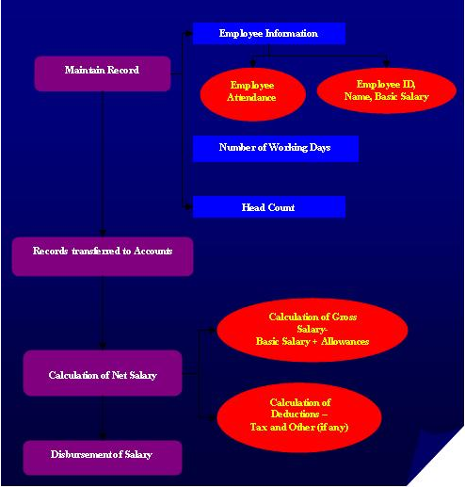

Slide 4
Database of employees is maintained. Employee’s details such as name, employee ID, basic salary, daily attendance, etc are recorded. Gross Salary is calculated after adding the allowances and incentives to the basic salary of the employesssse. Net salary is calculated by deducting the tax and other calculated deductions (loan installments, etc).
Payroll refers to the administration of employees' salaries, wages, bonuses, net pay, and deductions. It consist of the employee ID, employee name, date of joining, daily attendance record, basic salary, allowances, overtime pay, bonus, commissions, incentives, pay for holidays, vacations and sickness, value of meals and lodging etc. There are some deductions such as PF, taxes, loan installments or advances taken by employee.

Slide 5
Payroll is administered on monthly basis and annual basis.
While administrating the monthly payroll basic salary, HRA, conveyance, and other special allowances such mobile, etc are considered. There are some deductions. allowances such mobile, etc are considered. There are some deductions. which are provident fund (12%) of the salary, taxes and other deductions
Components of monthly payroll

Slide 6
Deductions such as tax and loan/advances taken by the employee from organizations are deducted only where applicable. Dearness Allowance and House rent allowance is provided at a fixed rate stated by the employment law. Provident fund is deducted from the gross salary of employee on the monthly basis as per the employment law, which is provided later to the employee. Organizations also contribute the same amount to the provident fund of the employee.
Annual payroll consists of leave travel allowances, incentives, annual bonuses, meal vouchers/reimbursements, and medical reimbursements
Annual payroll components

Slide 7
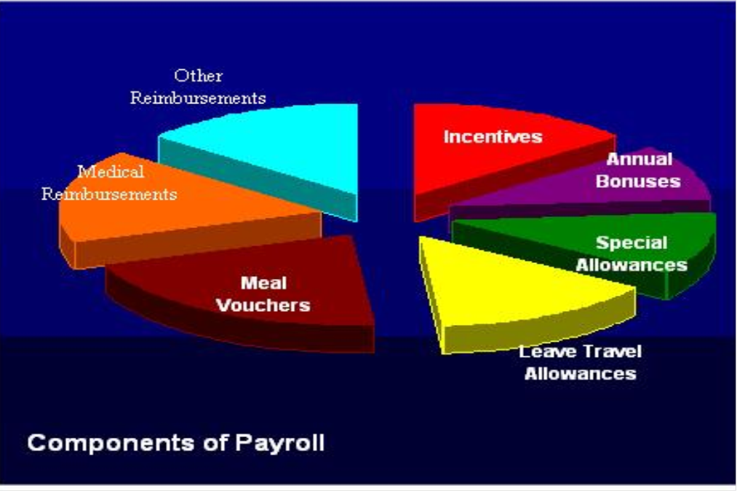

Slide 8
Allowances, incentives, bonuses and reimbursements are based on organizational policies. Some organizations provided the allowances on a fixed rate say 10% or 12% of the basic salary. Some organizations go for performance based incentives.
Calculation of gross salaries and deductible amounts is a tedious task which involves risk. Some of the organizations use the traditional manual method of payroll processing and some go for the advanced payroll processing software. An organization opts for any of the following payroll processing methods available::
Manual System
Manual payroll system is the traditional payroll system which involves pen and ink, adding machine, spreadsheet, etc. instead of computers, software and other computerized aids. The process was very popular when there were no computerized means for payroll processing.

Slide 9
Now-a-days it is only few small scale organizations in the remote areas that use the manual payroll. Sometimes the construction industry and manufacturing industry also use the manual payroll systems for the contractual labor, as theses contracts are on daily/weekly basis.
There is full control in the hands of owner. But the process is tedious, time consuming and risky as it is more prone to errors.
Various payroll Process

Slide 10
Accountant
Accountant is a professional having a degree/diploma course in finance/accountancy. He/she is responsible for all the activities related to payroll accounting. He/she has the sound knowledge of accounting principles and globally accepted standards.
The process adds costs to the organization. It involves paying someone who is responsible for calculating the salaries of others. The financial control regarding salary goes in the hand of accountant.
Payroll Software
In today’s computerized environment, payroll system has also developed itself into automated software that performs every action needed by the payroll process. It helps in calculating the payable amounts and deductions very easily. It also helps in generating the pay slips in lesser time. Automated calculations result in no errors. Data is validated automatically by the software.
It needs professionals to make use of the software for its efficient working

Slide 11
Payroll Outsourcing
Payroll outsourcing involves a third party (an outsourcing company) in the calculations of salaries and deductions. The outsourcing organization is responsible for all the activities of the payroll accounting. It saves time and cost for the organization. If there is more number of employees (say more than 900-1000) in the organization, payroll outsourcing would be very much beneficial.
The data is provided to the consultants/outsourcing firms. The various payroll functions undertaken by the outsourcing organizations are as follows:
Analysis of Payroll records, payroll taxes
Medical claim processing
Employee Insurance & Provident fund processing
Quality Audit procedures & planning

