Slide 1
What is a network?
A network consists of two or more computers that are linked in order to share resources (such as printers and CD-ROMs) , exchange files or allow electronic communications. The computers on a network may be linked through cables, telephone lines, radio waves, satellites or infrared light beams.

Slide 2
Network ATTRIBUTES
Type of Connection
  Point to point
  Multipoint
Physical Topology
  MESH
  STAR
  BUS
  RING
  TREE

Slide 3
  POINT TO POINT
  A Point to Point line configuration provides a dedicated link between two devices.
  The Entire capacity of channel is reserved for transmission between those two devices.
  Most point to point line configuration is the actual length of wire or cable to connect the two ends.

Slide 4
  Multi Point
  A multipoint (also called multi drop) line configuration in one which more than two specific devices share a single link.
  In multi point environment, the capacity of the channel is shared, either spatially or temporarily.

Slide 5
Topology
The term topology refers to the way a network is laid out, either physically or logically.
Two or more devices connect to link, two or more links form a topology.
The topology of a network is the geometric representation of the relationship of all the links and linking devices to each other.

Slide 6
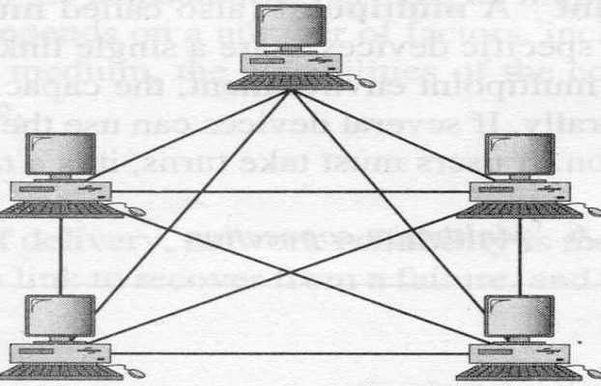
Mesh Topology

Slide 7
Mesh Topology
In a mesh topology, every device has a dedicated point to point link to every other device.
The term dedicated means that the link carries traffic only between the two devices it connects.
A fully connected mesh network has n(n-1)/2 physical channels to link n devices.
To accommodate that many links, every device on the network must have n-1 input/output (I/O) ports.

Slide 8
MESH TOPOLOGY
Advantages:
  Eliminates the traffic problems
  Robust.
  Privacy/Security
  Fault identification and fault isolation easy.
Disadvantages:
  no. of I/O ports and amount of cabling..
  Sheer bulk of wiring
  expensive

Slide 9
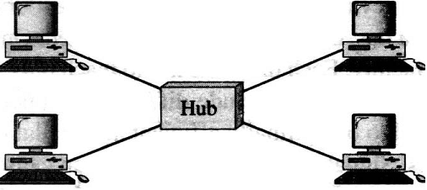
Star Topology

Slide 10
Star topology
In a star topology, each device has a dedicated point-to-point link only to a central controller, called a hub.
The devices are not directly linked to each other.
A star topology does not allow direct traffic between devices.
The Controller acts as an exchange.
If one device wants to send data to another, it sends the data to the controller which then relays the data to the other connected device.

Slide 11
STAR topology
Advantages
A star topology is less expensive-needs one link and one I/O port.
It is easy to install and reconfigure.
Star topology is robust . If one link fails, only that link is affected.
Disadvantage
Although, a star requires far less cable than mesh, each node must be linked to central hub.

Slide 12
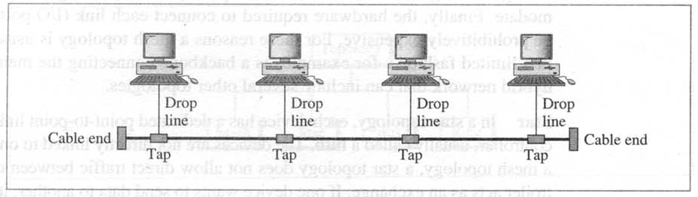
Bus topology

Slide 13
Bus topology
Bus topology is a multi point.
One long cable acts as a backbone to link all the devices in a network.
Nodes are connected to the bus cable by drop lines and taps.
Drop line is a connection running between the device and the main cable.
A tap is a connector.

Slide 14
Bus topology
Advantages
  Ease of Installation
  Uses less cabling than mesh and star topology
  Addition of new nodes to the network is easy.
  Failure of node does not affect communication among other nodes in the network.
Disadvantages
  If the shared communication line fails, entire network fails and line stops tansmission.
  Difficult reconfiguration and fault isolation.

Slide 15
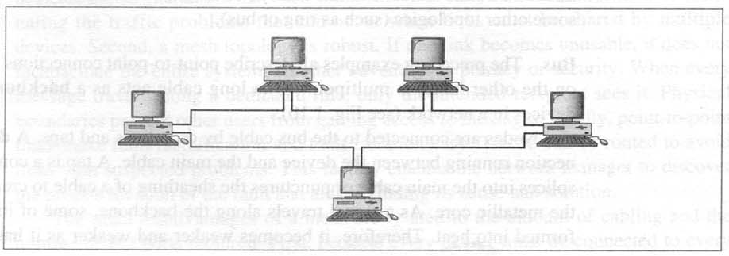
RING TOPOLOGY

Slide 16
RING TOPOLOGY
Each device has a dedicated point-to-point connection only with the two devices on either side of it.
A signal is passed along the ring in one direction, from device to device, until it reaches its destination.
Each device in the ring incorporates a repeater. When a device receives a signal intended for another device, its repeater regenerates the bits and passes them along.

Slide 17
RING TOPOLOGY
A ring is easy to install and reconfigure. Each device is linked only to its immediate neighbors. To add or delete a device requires changing only two connections.
The only constraints are media and traffic considerations.
In addition fault isolation is simplified.
Generally in a ring, a signal is circulating all the times. If one device does not receive a signal within a specified period, it can issue an alarm. The alarm alerts the network operator to the problem and its location.

Slide 18
RING TOPOLOGY
Advantages
  Ring network works well where there is no central node for making decisions.
  It is more reliable than a star network because communication is not dependent on a single central node. If a link between any two nodes fails, alternate routing is possible.
Disadvantages
  In a ring network, communication delay is directly proportional to number of nodes in the network. Hence, addition of new nodes in a network increases communication delay.
  It requires more complicated control software than star network.

Slide 19
Tree Network
HUB
HUB
HUB
HUB

Slide 20
TREE TOPOLOGY
A Tree topology is a variation of star.
As in a star, nodes in a tree are linked to a central hub that controls the traffic to the network.
In tree, not every device plugs directly into the central hub. The majority of devices connect to a secondary hub that in turn is connected to the central hub.
The central hub in the tree is an active hub.
An active hub contains a repeater, which is a hardware device that generates the received bit patterns before sending them out.
The secondary hubs may be active or passive hubs.
A passive hub provides a simple physical connection between the attached devices.

Slide 21
TREE TOPOLOGY
Advantages
  Due to the addition of secondary hubs, it allows more devices to be attached to a single central hub and can therefore increase the distance a signal can travel between devices.
  It allows the network to isolate and prioritize communications from different computers. Due to this, time sensitive data will not have to wait for access to the network.

Slide 22
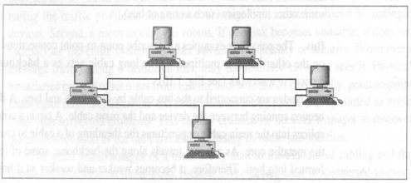
Hybrid TOPOLOGY
HUB

Slide 23
HYBRID TOPOLOGY
When a network combines several topologies or a sub networks linked together in a larger topology, they are known as a hybrid topology.

Slide 24
Transmission mode
The transmission mode is used to define the direction of flow between two linked devices.
There are three types of transmission mode:
  Simplex
  Half Duplex
  Full Duplex

Slide 25
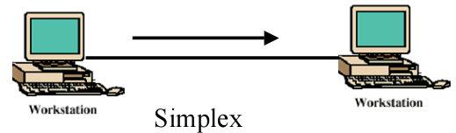
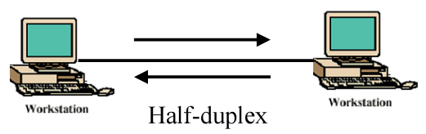
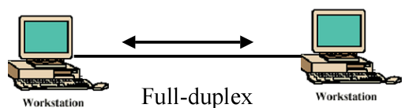
Direction of Data Flow

Slide 26
DIRECTION OF FLOW
Simplex
–In a simplex mode, the communication is unidirectional,
as on a one way street.
- Only one of two stations can transmit and other can only
receive. e.g. Television
•Half Duplex
-each station can both transmit and receive, but not at the
same time.
-When one device is sending, the other can only receive
and vice versa. e.g. police radio
- In a half duplex transmission, the entire capacity of a
channel is taken over by whichever of the device is
transmitting that time.
Full duplex
- Both stations can transmit and receive simultaneously
- In this mode, signals going in either direction share the
capacity of the link. e.g. telephone

Slide 27
CLIENT SERVER MODEL
A client is a program on the local machine requesting service from a server which means it is started by the user(or other application program) and terminates when the service is complete.
A Server is a program running on the remote machine providing service to the clients.
When it starts, it opens the door for incoming requests from clients, but it never initiates a service until it is requested to do so.
A server program is an infinite program. When it starts, it runs infinitely unless a problem arises. It waits for incoming requests from clients. When a request arrives, it responds to the request.
CLIENT
SERVER

