Slide 1
OSI MODEL
An ISO is a multi national body dedicated to worldwide agreement on international standards.
An ISO standard that covers all aspects of network communications is open systems Interconnection (OSI) model.
An open system is a model that allows any two different systems to communicate regardless of their underlying architecture.
The OSI is not a Protocol, it is a model for understanding and designing a network architecture that is flexible, robust, and interoperable.

Slide 2
OSI MODEL

Slide 3
7 Layers
All
People
Seem
To
Need
Data
Processing
7 Application Layer
Presentation Layer
Session Layer
Transport Layer
Network Layer
Data Link Layer
Physical Layer

Slide 4
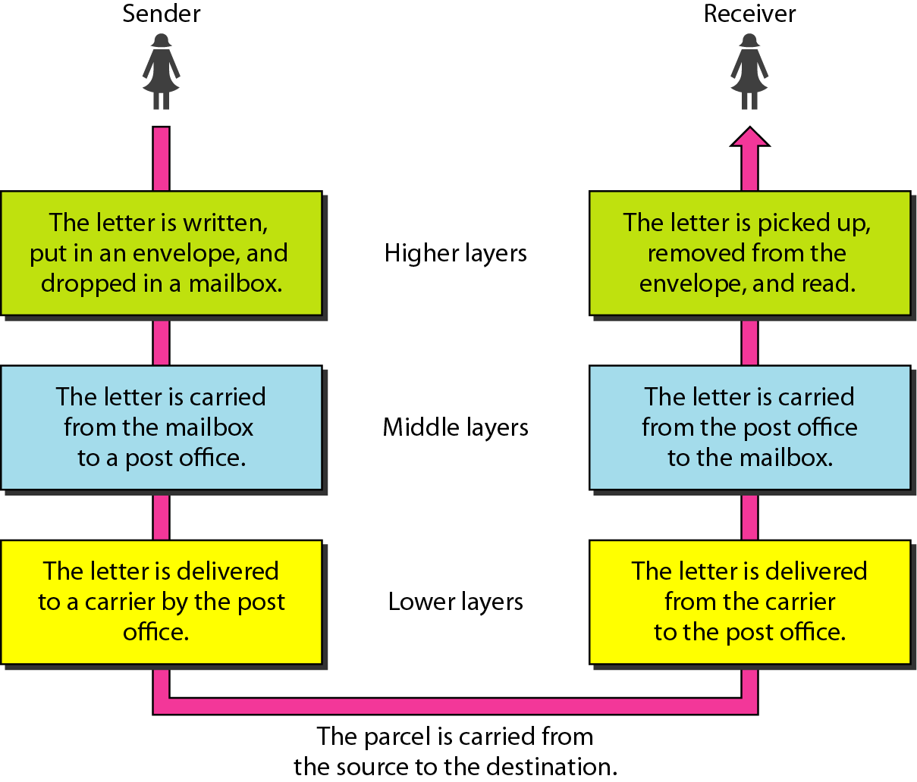
Task Involved in sending a letter

Slide 5
Application
Application
Prese ntation
Prese ntation
Session
Session
Transport
Transport
Network
Network
Data Link
Data Link
Physical
Physical

Slide 6
Peer to peer process
Within a single machine, each layer calls upon the services of the layer below it and provides services to layer above it.
For example, Layer 3 uses the services provided by layer 2 and provides services for layer 4.
This communication is governed by an agreed upon series of rules and conventions called protocols.
The processes on each machine that communicate at given layer are called peer to peer processes.
At physical layer, communication is direct.
Each layer in the sending machine add its own information to the message it receives from the layer just above it and passes the whole package to the layer just below it.
This information is added in the form of Header and Trailer.
Headers are added to the message at layers 6,5,4,3 and 2.
A trailer is added at layer 2.
At layer 1 entire package is converted to a form that can be transferred to the receiving machine.

Slide 7
Figure 3-3
An Exchange Using the OSI Model
H6
H6
H5
H5
H4
H4
H3
H3
H2
H2
WCB/McGraw-Hill
© The McGraw-Hill Companies, Inc., 1998

Slide 8
ORGANIZATION OF LAYERS
Layers 1,2 and 3 –physical, data link and network- are the network support layers which deals with the physical aspects of moving data from one device to another.
  Electrical specifications
  Physical connections
  Physical addressing
  Transport timing
Layers 5,6,and 7 – Session, Presentation and Application are user support layers.
They allow interoperability among unrelated software systems.
Layer 4, transport layer ensures end to end reliable data transmission.
Layer 2 ensures reliable transmission on the link.
The upper OSI layers are always implemented in software.
Lower layers are a combinations of hardware and software.
Physical layer is mostly a hardware.

Slide 9
OSI Model Layers
The process starts out at layer 7 and then moves from layer to layer in a descending sequential order.
At each layer (except 7 and 1), a header is added to the data unit.
At layer 2, trailer is added.
When the formatted data passes through the physical layer (layer 1), it is changed into an electromagnetic signal and transported along the physical link.
Upon reaching its destination, the signal passes into layer 1 and is transformed back into bits.
The data units then move back up through the OSI layers.
As each block of data reaches to next higher layer, the headers and trailers attached to it at the corresponding sending layers are removed and applications appropriate to the layer taken.
At last it reaches layer 7, the message is again in a form appropriate to the application and is made available to the recipient .

Slide 10
PHYSICAL LAYER

Slide 11
PHYSICAL LAYER
Physical layer coordinates the functions required to transmit a bit stream over a physical medium.
Physical layer is concerned with following:
  Physical Characteristics of interfaces and media:
    Provides interface between the devices and transmission medium.
  Representation of bits:
    Represents stream of bits without any interpretation
    Encode the data from 0 and 1 format to electrical and optical and defines type of encoding.
  Data Rate
    Transmission rate means the number of bits sent per each second.
    It is defined by physical layer.
  Synchronization of bits:
    The sender and receiver must be synchronized at the bit level.
  Line configuration:
    It is concerned with Connection of two devices which can be point to point or multipoint.
  Physical Topology:
    How devices are connected to make a network.
  Transmission mode:
    Direction of transmission mode.

Slide 12
DATA LINK LAYER

Slide 13
DATA LINK LAYER

Slide 14
DATA LINK LAYER
Responsibilities of Data Link Layer
Framing
  The data link layer divides the stream of bits received from the network layer into manageable data units called frames.
Physical Addressing
  If frames are to be distributed to different systems on the network, the data link layer adds a header to the frame to define physical address of the sender and/or receiver (destination address) of the frame.
Flow Control
  If the rate at which the data are absorbed by the receiver is less than the rate produced in the sender, the data link layer imposes a flow control mechanism to prevent overwhelming the receiver.
Error Control
  The data link layer adds reliability to the physical layer by adding mechanism to detect and retransmit damaged or lost frames.
  Provides a mechanism for preventing duplication of frames.
Access Control
  When two or more devices are connected to the same link, data link layer protocols are necessary to determine which device has a control over the line at given time.

Slide 15
NETWORK LAYER

Slide 16
NETWORK LAYER

Slide 17
NETWORK LAYER

Slide 18
NETWORK LAYEr
The network layer is responsible for the source to destination delivery of a packet possibly across multiple network.
Whereas the data link layer oversees the delivery of the packet between two systems on the same network(links), the network layer ensures that each packet gets from its point of origin to its final destination.
If two links are connected to the same link, there is no need of Network layer.
If the two systems are connected to two different network (links) with the connecting devices between the network, there is often a need for the network layer to accomplish source to destination delivery.

Slide 19
NETWORK LAYER
Responsibilities of Network Layer
  Logical Addressing
    If a packet passes the network boundary, there is a need of another addressing system to help distinguish the source and destination systems.
    The network layer adds a header to the packet coming from the upper layer which includes logical addresses of the sender and receiver.
  Routing
    When independent networks or links are connected together to create an internetwork or a large network, the connecting devices called routers route the packets to their final destination. Network layer is responsible for providing this mechanism.

Slide 20
TRANSPORT LAYER

Slide 21
TRANSPORT LAYER example

Slide 22
TRANSPORT LAYEr
The transport layer is responsible for source to destination delivery of entire message.
Network layer oversees end-to-end delivery of individual packets, it does not recognize any relationship between those packets. It treats each one independently, as though each piece belonged to a separate message, whether or not it does.
The transport layer ensures that the whole message arrives intact and in order.

Slide 23
TRANSPORT LAYER
Responsibilities:-
  Service Point Addressing
    Source to destination delivery means delivery not only from one computer to the next but also from a specific process (running Program) on one computer to a specific process (running Program) on the order.
    The transport layer header include a type of address called a service-point address or port address.
  Segmentation and reassembly
    A Message is divided into transmittable segments, each segment containing a sequence number.
    These number enable the transport layer to reassemble the message correctly upon arriving at the destination and to identify and replace packets that were lost in the transmission.

Slide 24
TRANSPORT LAYER
  Connection Control
    The transport layer can be either connection less connection oriented.
    A connection less transport layer treats each segment as an independent packet and delivers it to the transport layer at the destination machine.
    A connection oriented transport layer makes a connection with the transport layer at the destination machine first before delivering the packets.
  Flow Control
    Transport layer is responsible for flow control like a data link layer.
  Error Control
    Transport layer is responsible for error control.
    Sending transport layer makes sure that the entire message arrives at the receiving transport layer without error.

Slide 25
session layer

Slide 26
SESSION LAYER
The services provided by the first three layers are not sufficient for some process.
The session layer is the network dialog controller which establishes, maintains and synchronizes the interaction between communicating systems.
Responsibilities:
  Dialog Control
    The session layer allows two systems to enter into a dialog.
    It allows the communication between two processes to take place either in a half duplex or full duplex .
  Synchronization
    The session layer allows a process to add checkpoints into a stream of data.
    For example, if a system is sending a file of 2000 pages, it is advisable to insert checkpoints after every 100 pages. So if any crash occurs at page 523, then retransmission begins at 501 and 1 to 500 pages need not to be retransmitted.

Slide 27
PRESENTATION LAYER

Slide 28
Presentation layer
The presentation layer is concerned with the syntax and semantics of the information exchanged between two systems.
Responsibilities:
  Translation:
    The processes in two systems are usually exchanging information in the form of character string, number and so on.
    The information should be changed into bit streams before being transmitted.
    Different computers are using different encoding systems, presentation layer is responsible for interoperability between these different encoding systems.
    The presentation layer at sender changes the information from sender dependent format to common format and the presentation layer at receiver changes information from common format to receiver dependent format.

Slide 29
Presentation layer
  Encryption:
    Encryption means that the sender transforms the original information into another form and sends the resulting message out over the network.
    Decryption reverse the original process to transform the message back into the original message.
  Compression:
    Data compression reduces the number of bits to be transmitted.
    Data compression becomes particularly important in the transmission of multimedia such as text, audio and video.

Slide 30
Application layer
The application layer enables user to access the network.
It provides interface and support for services such as electronic mail, remote file access and transfer, shared database management and other types of distributed information services.
Responsibilities:
  Network Virtual Terminal:
    A network virtual terminal is a software version of a physical terminal and allows a user to log on to a remote host.
    The user’s computer talks to the software terminal, which in turn talk to the host, and vice versa.
    The remote host believe it is communicating with one of its own terminals and allows you to log on.
  File transfer, access and management:
    This application allows a user to access files in a remote computer, to retrieve from a remote computer and to manage or control files in a remote computer.
  Mai Services:
    This application provides the basis for email forwarding and storage.
  Directory Services:
    This application provides distributed database sources and access for global information about various objects and services.

