Slide 1
Network Layer - an Overview
Getting data packets from the source all the way to the destination
Dealing with end-to-end transmission
Need to know
  Topology of the communication subnet (routers)
  Chose paths (routing algorithms)

Slide 2
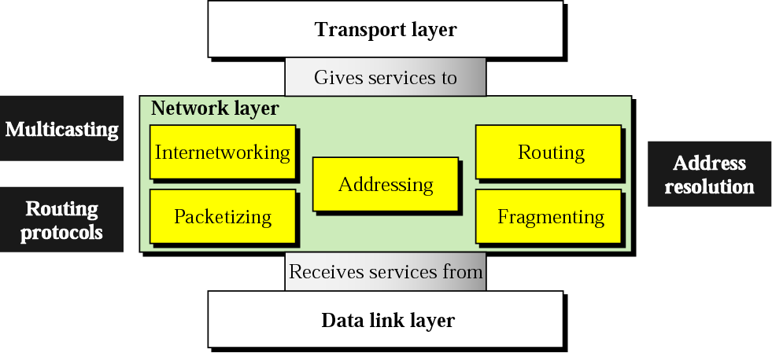
Position of Network Layer

Slide 3
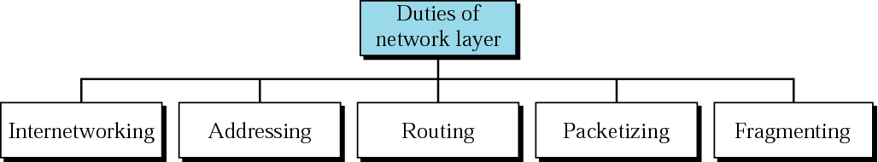
Network Layer Duties

Slide 4
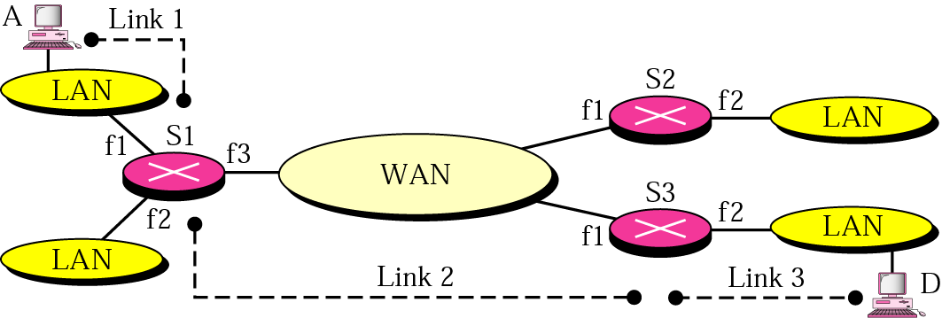
Internetworks
Host A -> Host D
4 LANS, 1 WAN
S1, S2, S3: Switch or Router
f1, f2: Interface
Three links: S1 -> S2 -> s3

Slide 5
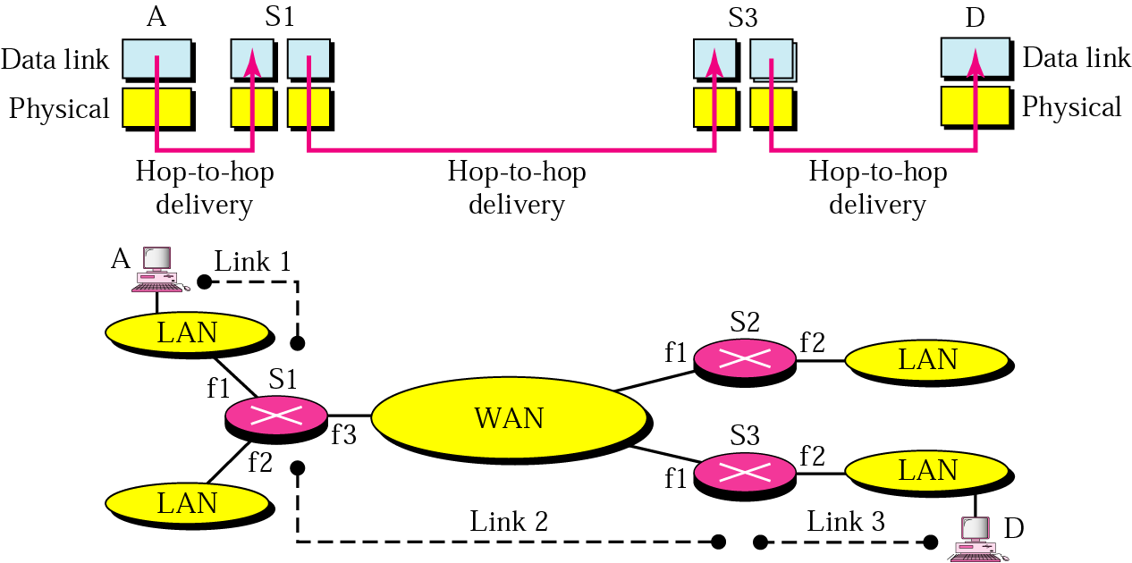
Links in an Internetwork

Slide 6
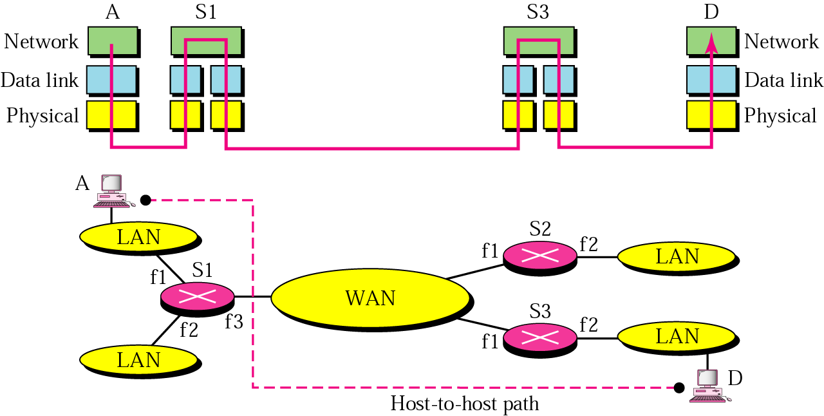
Network Layer in an Internetwork
Courtesy - From Fig. 19.3 Page 473, Data Communications and Networks, 3rd edition, Forouzan, McGrawHill

Slide 7
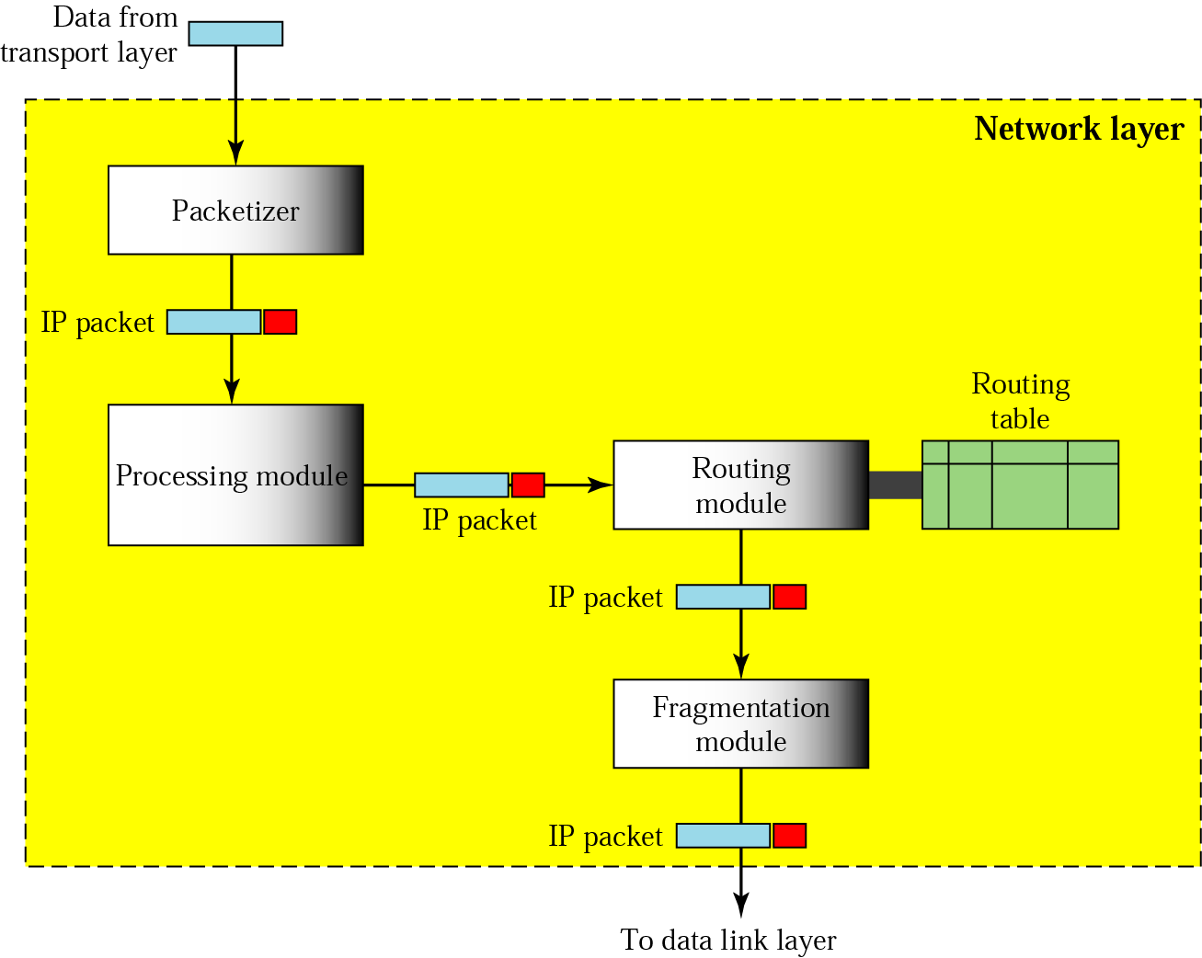
Network Layer at the Source
Creating Source and Destination Address, Fragmentation
Courtesy - From Fig. 19.4 Page 473, Data Communications and Networks, 3rd edition, Forouzan, McGrawHill

Slide 8
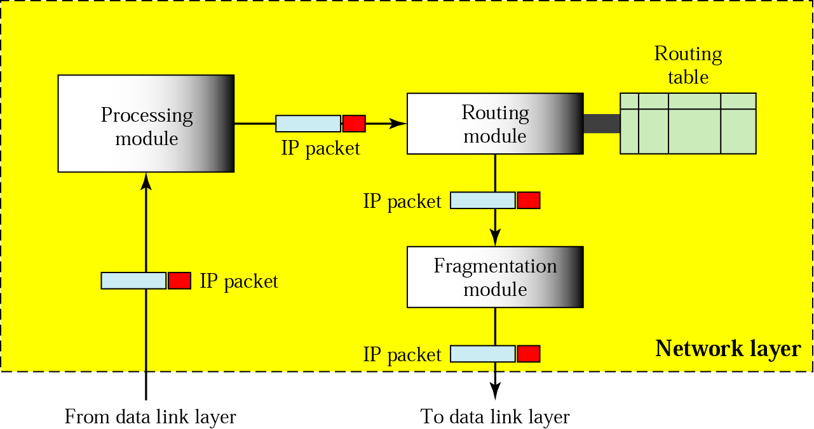
Network Layer at Router or Switch
Routing Table, Fragmentation
Courtesy - From Fig. 19.5 Page 474, Data Communications and Networks, 3rd edition, Forouzan, McGrawHill

Slide 9
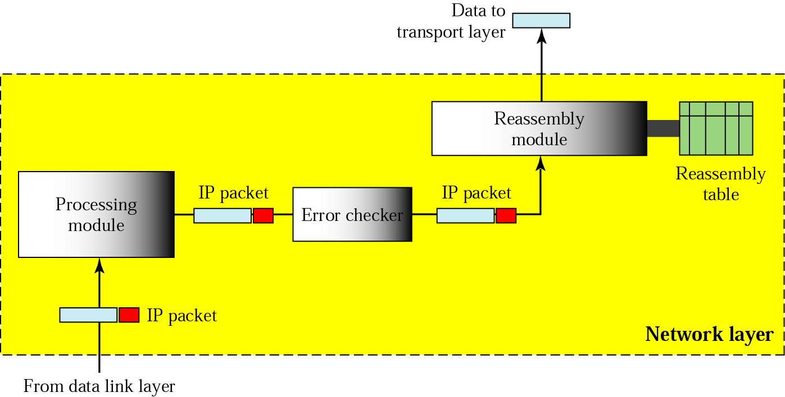
Network Layer at Destination
Corrupted packet, Fragments
Courtesy - From Fig. 196 Page 475, Data Communications and Networks, 3rd edition, Forouzan, McGrawHill

Slide 10
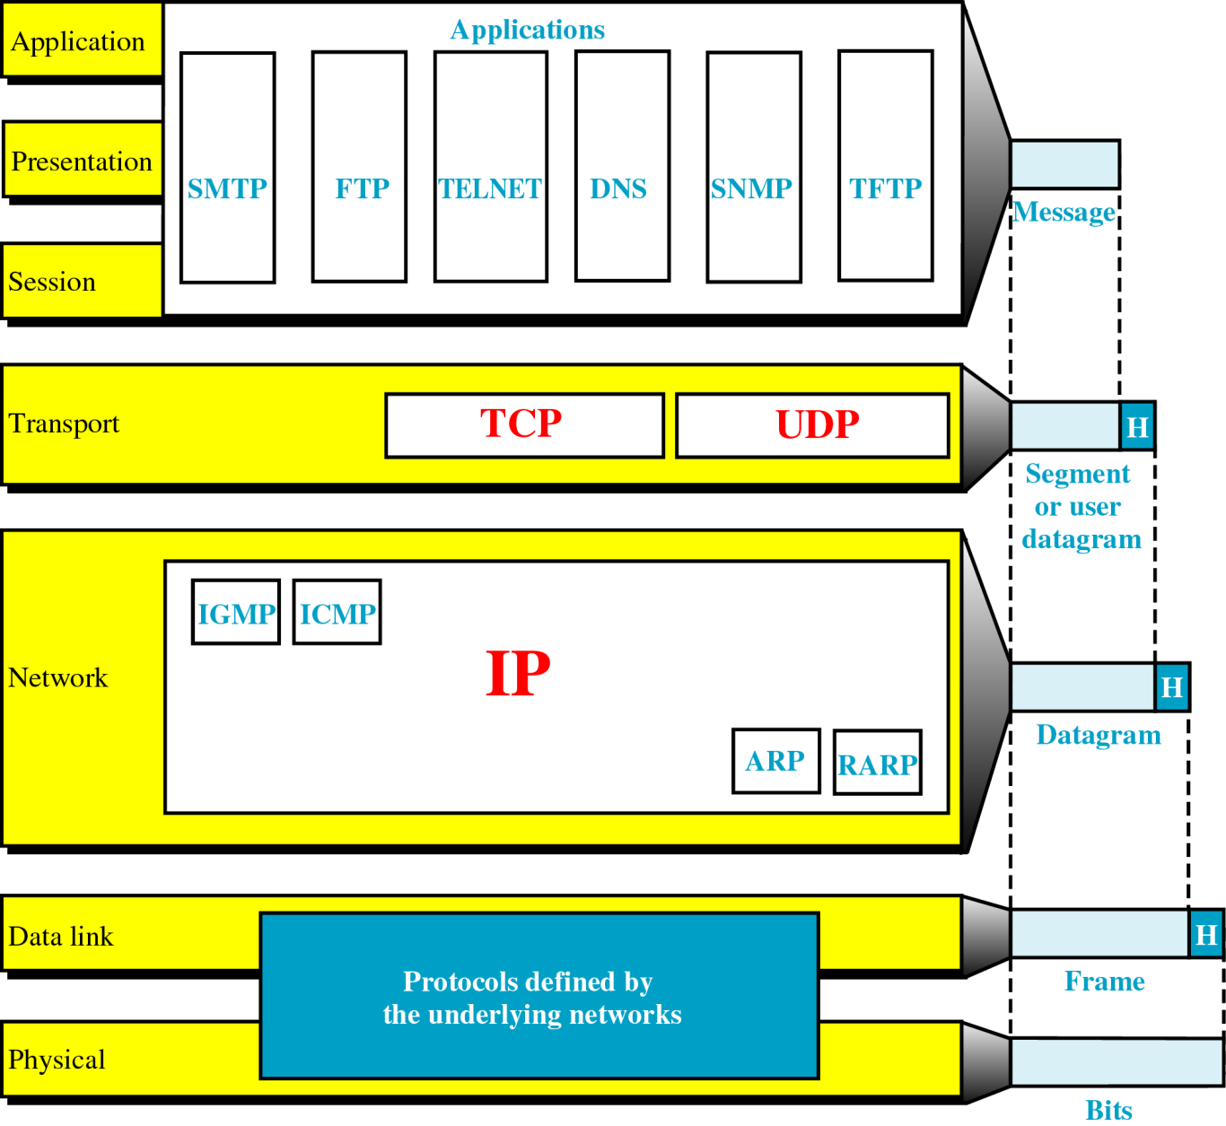
Figure 24-2
TCP/IP and the OSI Model

Slide 11
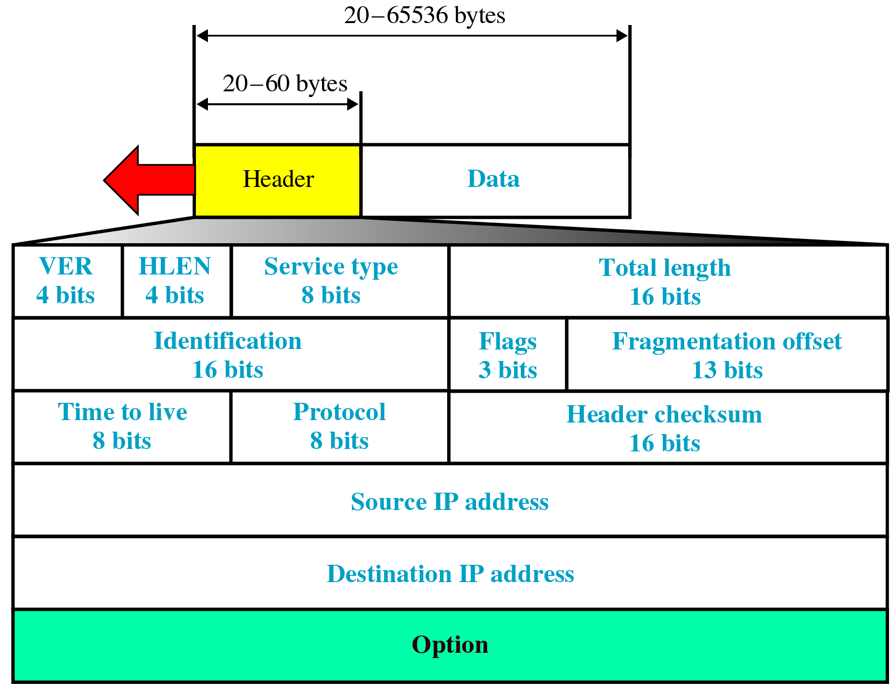
Figure 24-3
IP Datagram

Slide 12
INTERNETWORKING PROTOCOL
The internetworking protocol is the transmission mechanism used by TCP/IP Protocol.
It is unreliable and connectionless datagram protocol.
The IP provides no error checking or tracking.
IP assumes the unreliability of the underlying layer and does its best to get a transmission through its destination, but with no guarantee.
IP transports data in Packets called datagrams , each of which transported separately.
Datagrams can travel along different routes and can arrive out of sequence or be duplicated.
IP does not keep track of the routes and has no facility for reordering datagrams once they arrive at their destination.

Slide 13
INTERNETWORKING PROTOCOL
Packets in the IP layer are called datagrams.
A datagram is a variable length packet consisting of two parts:
  Header
  Data

Slide 14
INTERNETWORKING PROTOCOL
Version:
  - The first field defines the version number of the IP.
(2) Header Length (HLEN):
- It defines length of header in a multiple of four bytes.
- It varies from 0 to 15.
(3) Service Type:
- The service type fields defines how the datagram should
be handled.
- It includes the bit that defines a parity of a datagram.
(4) Total Length:
- The total length defines the total length of an IP
datagram.
- It is 2 byte field and can end up to 65,535 bytes.

Slide 15
INTERNETWORKING PROTOCOL
(5) Identification:
- It is used in fragmentation.
- A datagram, when passing through different networks,
may be divided into fragments to match the network
frame size.
- When this happens , each fragment is identified with a
sequence number in this field.
(6) Flags:
- The bit in the flags field deal with fragmentation.
(7) Fragmentation offset:
- It is a pointer that shows the offset of the data in the
original datagram.

Slide 16
INTERNETWORKING PROTOCOL
(8) Time to Live:
- The time to live field defines the number of hops a
datagram can travel before it is discarded.
- The source host, when it creates the datagram, sets this
field to an initial value.
- Then, as datagram travels through the Internet, router
by router , each router decrements its value by 1 and if
it becomes 0 before it reaches to its final destination,
the datagram is discarded.
(9) Protocol:
- The protocol field defines which upper layer protocol
data are encapsulated in the datagram. (TCP, UDP,
ICMP, etc.).

Slide 17
INTERNETWORKING PROTOCOL
(10) Header Checksum:
- This is a 6 bit field used to check the integrity of the
header, not the rest of the packet.
(11) Source Address:
(12) Destination Address:
(13) Options:
- This field gives more functionality to the IP datagram.
- It can carry fields that control routing, timing,
management, and alignment.

Slide 18
Routing Algorithms
In routing the pathway with the lowest cost is
considered the best.
Two common methods are used to calculate the
shortest path between two routers:
(1) Distance Vector Routing
(2) Link State Routing

Slide 19
Distance Vector Routing
This algorithm works as:
  Knowledge about the whole network:
    Each router shares the knowledge about the entire network.
    It sends all of its collected knowledge about the network to its neighbors.
  Routing only to neighbors:
  → Each router periodically sends its knowledge about the
  network only to those routers to which it has direct links.
  →It sends whatever knowledge it has about the whole
  network through all of its ports.
  (3) Information sharing at regular intervals:
  → It sends its information at regular interval.
  → for example . After every 30 seconds it sends information.

Slide 20
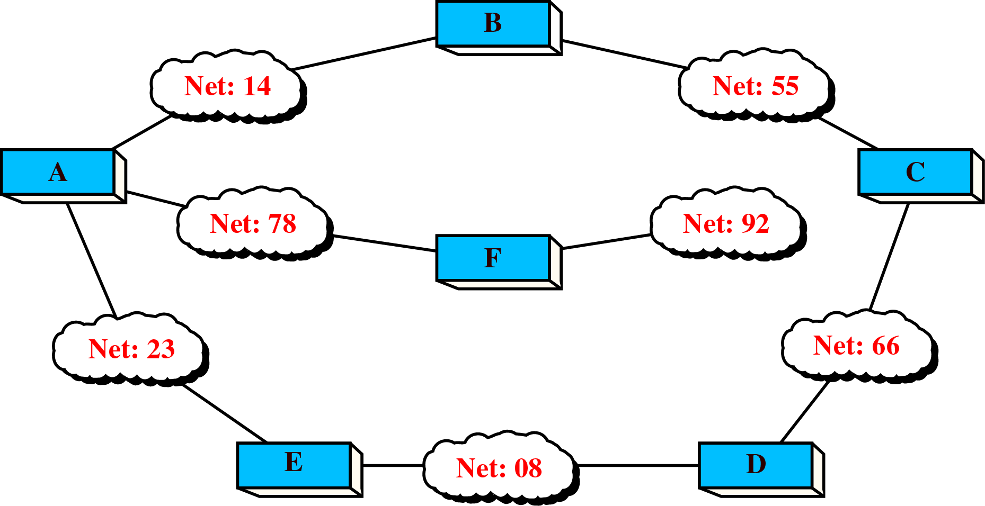
Distance Vector Routing

Slide 21
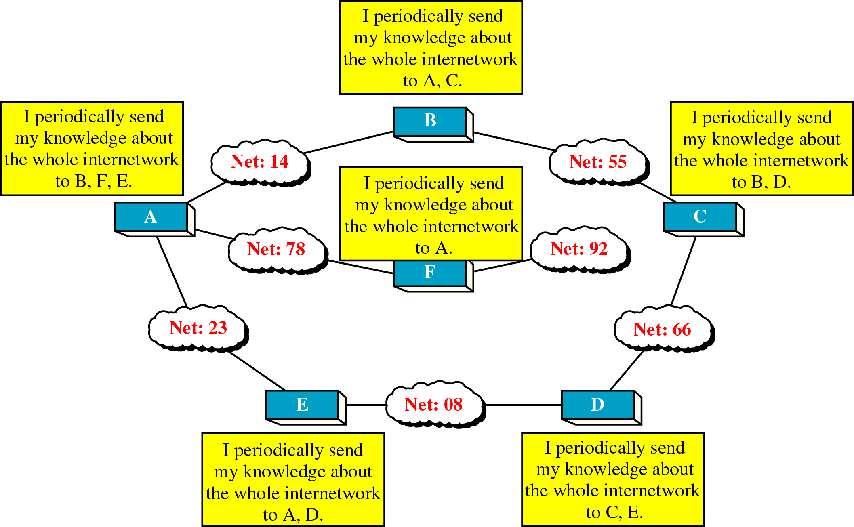
Distance Vector Routing

Slide 22
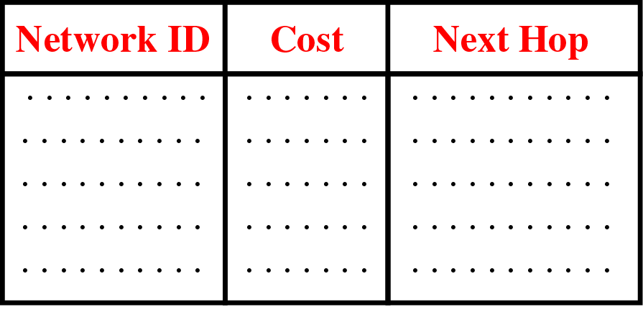
Distance Vector Routing Table
The network ID is the final destination of the packet.
The cost is the number of hops a packet must make to
get there.
Next hop is the router to which a packet must be
delivered on its way to particular destination.
The table tells a router that it costs x to reach network Y
via router Z.

Slide 23
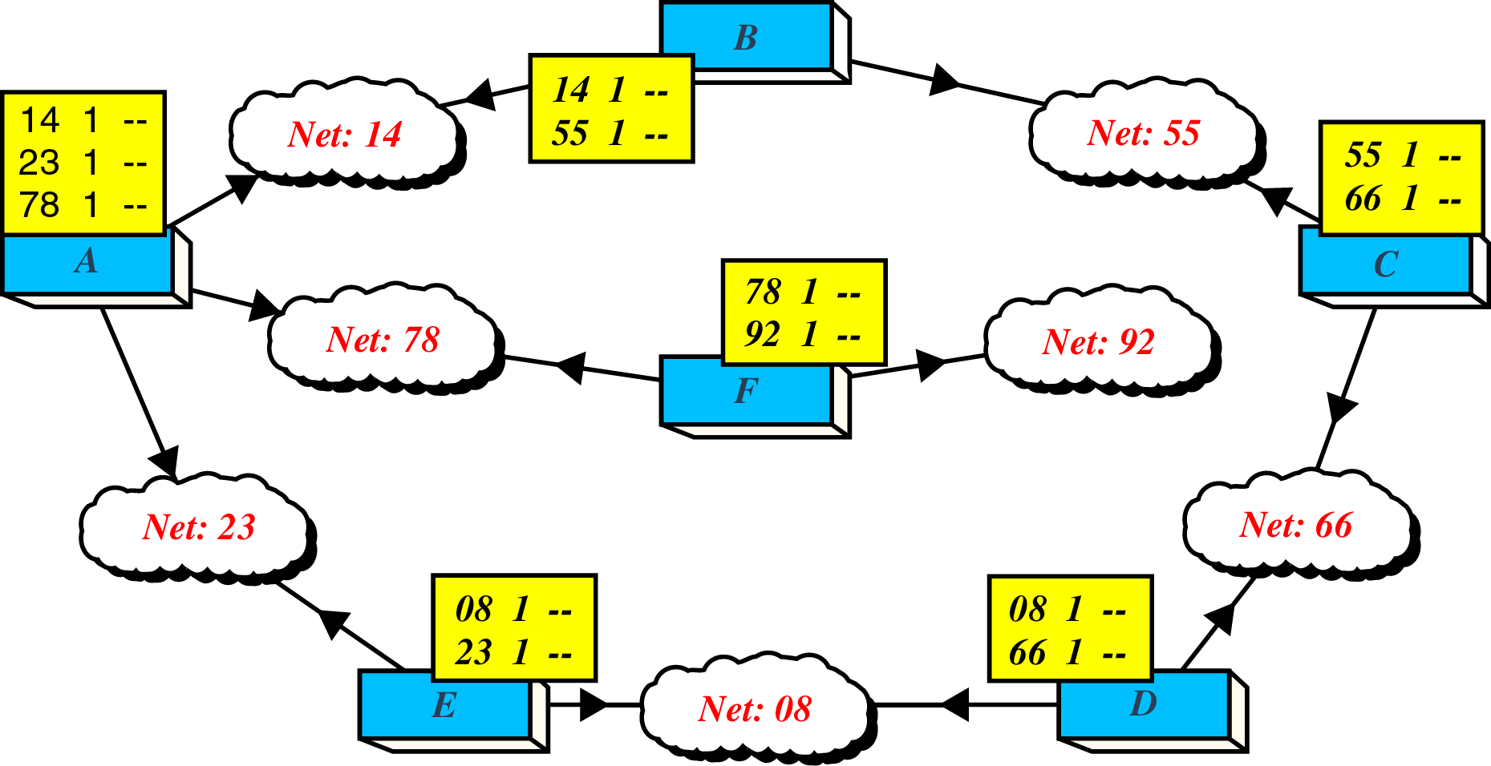
Figure 21-20
Routing Table Distribution

Slide 24
Updating a routing Table
→ When A receives a routing table form B, it uses
the information to update it its own table,
It says to itself:
  “ B has sent me a table that shows how its packets can get to network 55 and 14.
  “ I know that B is my neighbor, so my packets can reach B in one hop.”
  “ So, if I add one more hop to all of the costs shown in B’s table, the sum will be my cost for reaching those other networks”

Slide 25
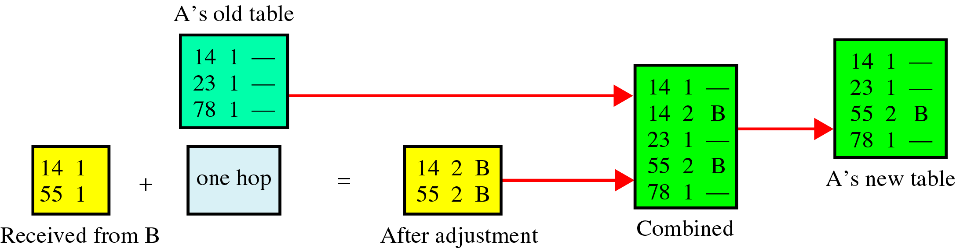
Updating routing table for router A

Slide 26
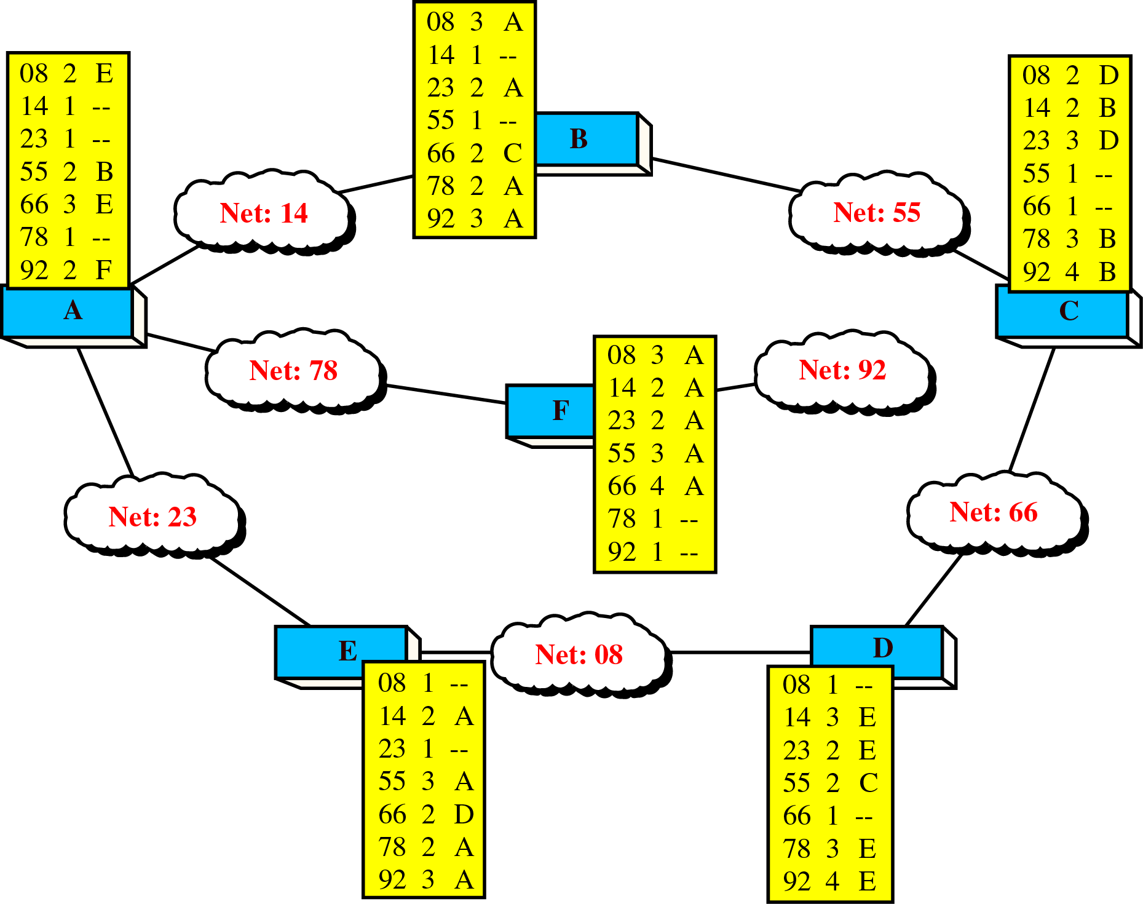
Final Routing table

Slide 27
Updating a Routing Table rules
If the advertised destination is not in the routing table, the router should add the advertised information to the table.
If the advertised destination is in the routing table,
  If the next hop field is the same, the router should replace the entry in the table with the advertised one. Even if the advertised hop count is larger, the advertised entry should replace the entry in the table because the new information invalidated the old.
  If the next hop field is not the same,
    If the advertised hop count is smaller than the one in the table, the router should replace the entry in the table with the new one.
    If the advertised hop count is not smaller, the router should do nothing.

Slide 28
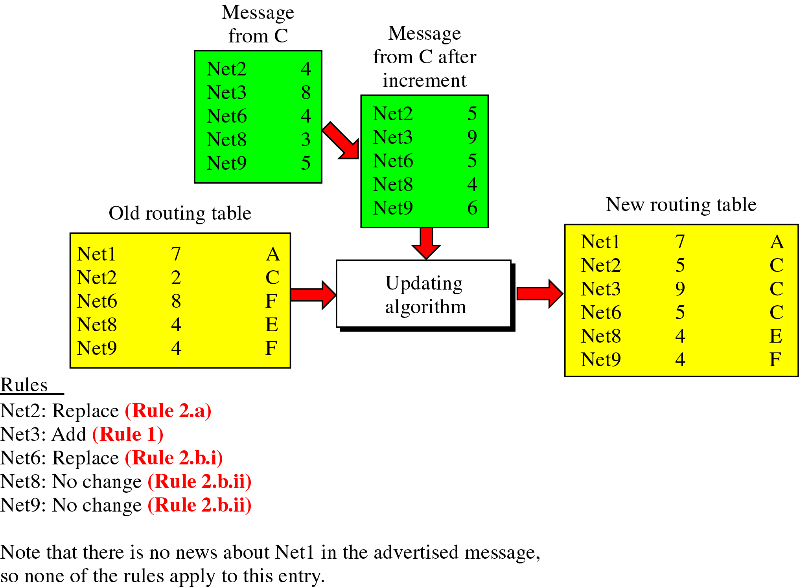
Updating a Routing Table rules

Slide 29
Link State Routing
Rules for algorithm:
Knowledge about the neighborhood:
→Instead of sending its entire routing table, a router sends
information about its neighborhood only.
(2) To all routers:
→ Each router sends this information to every other router on
the internetwork, not just to its neighbors.
(3) Information sharing when there is a change:
→ Each router sends out information about the neighbors when
there is a change.

Slide 30
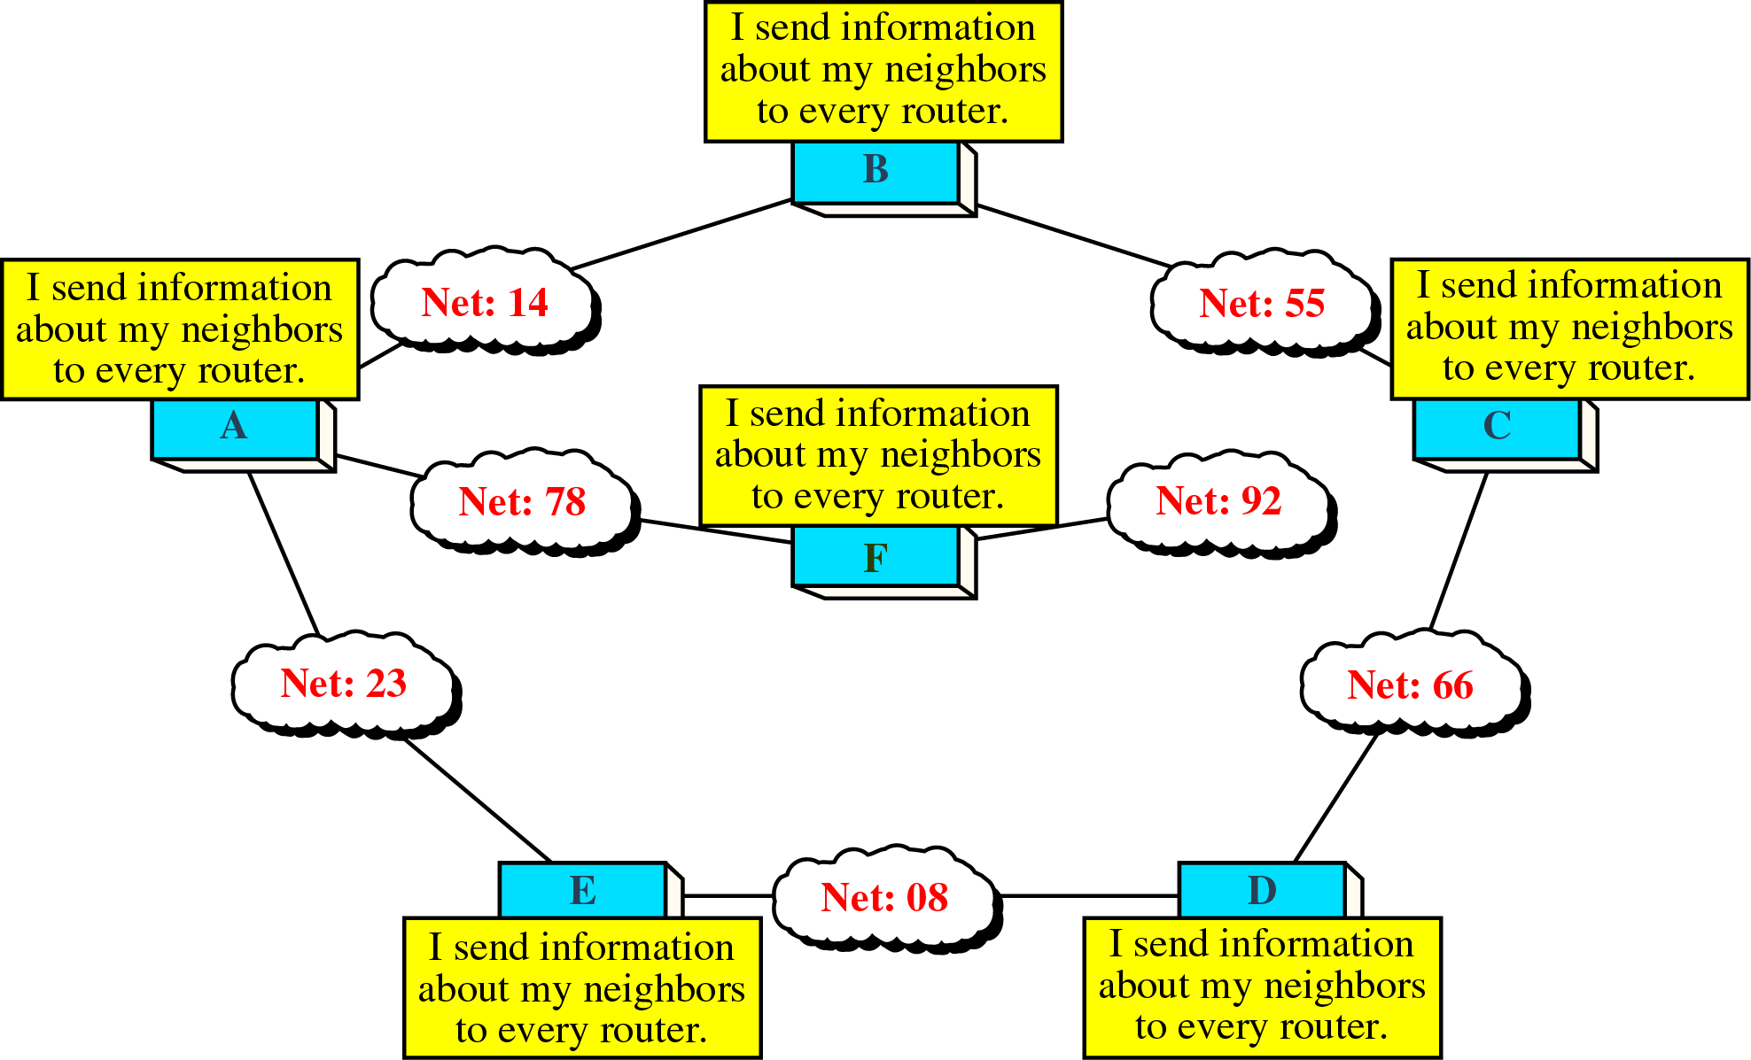
Link State Routing

Slide 31
Packet Cost
In distance vector routing , cost refers to a hop count.
In link state routing, cost is weighted value based on a variety of factors such as security levels, traffic, or the state of the link.

Slide 32
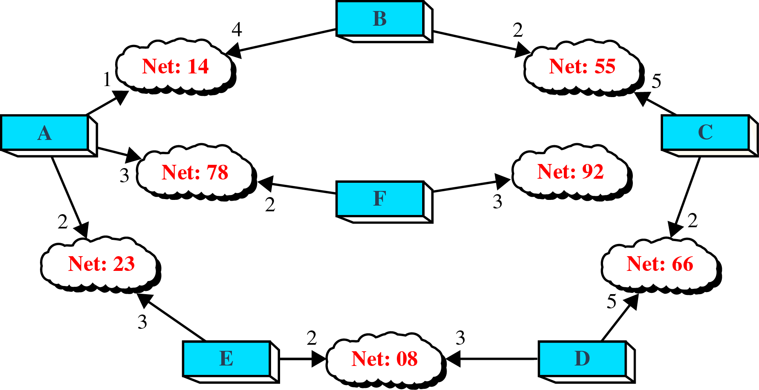
Packet Cost

Slide 33
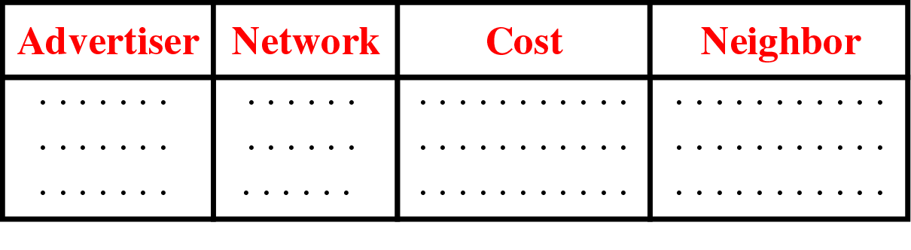
Packet Cost

Slide 34
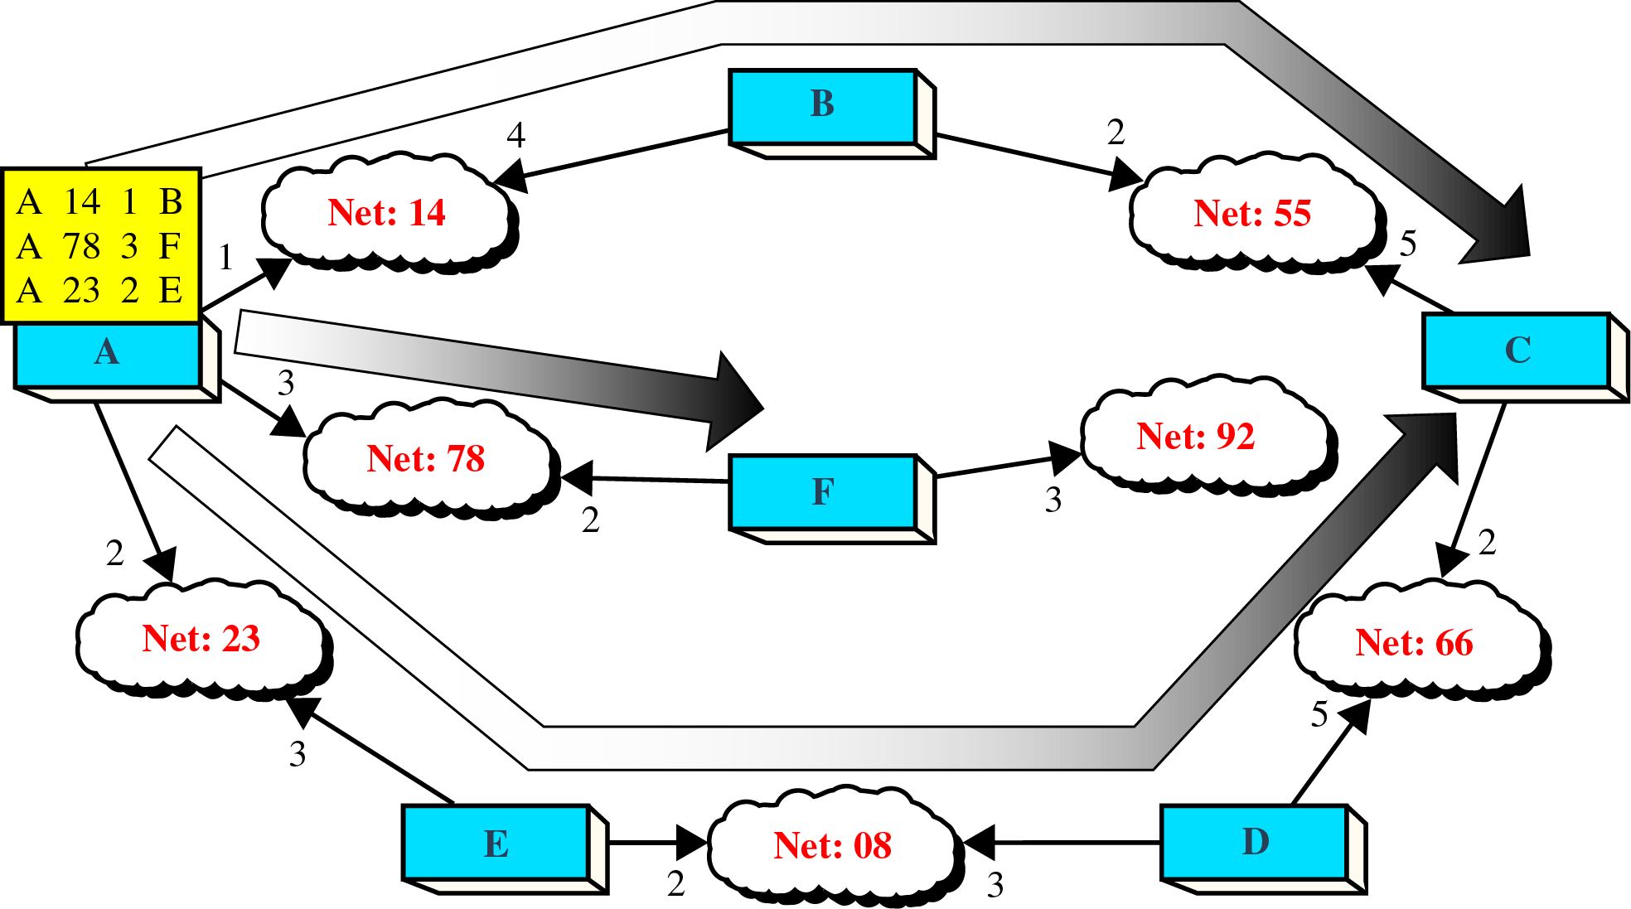
Flooding of A’s LSP

Slide 35
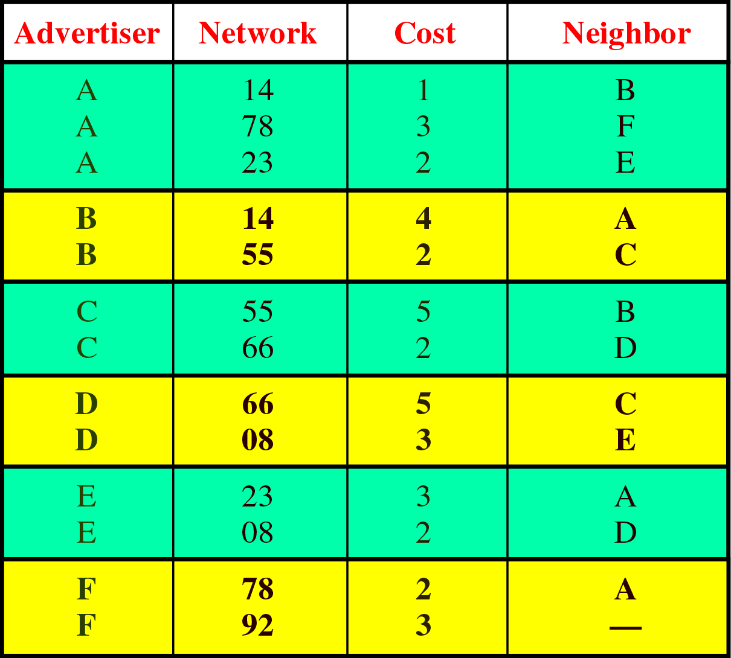
Link state database

Slide 36
Different types of address
Three different levels of addresses are used in an internet using TCP/IP protocols:
  Physical Address
  Logical Address
  Port Address

Slide 37
Physical Address
It is also known as link address.
It is defined by its LAN or WAN.
It is lowest level address.
It has an authority over the network.
It can be either
  Unicast ( One single recipient)
  Multicast (a group of a recipients)
  Broadcast ( To be received by all systems in the network.)
Some networks supports all three addresses.

Slide 38
Addressing

Slide 39
Logical Address
Logical addresses are necessary for universal communication services that are independent of underlying physical networks.
Physical addresses are not adequate in an internetwork environment where different networks can have different address formats.
The logical addresses are designed for internetwork communication.
It is currently 32-bit address that can uniquely define a host connected to the internet.
It can be either unicast, broadcast or multicast.

Slide 40
Port Address
IP address and physical address are necessary for source to destination host transmission.
The aim of internet communication is a process communicating with the another process.
For example,
  Computer A can communicate with C by TELNET
  Computer A communicate with B by FTP.
For these process occur simultaneously, each process should be labeled.
They are labeled by an address called port address.

Slide 41
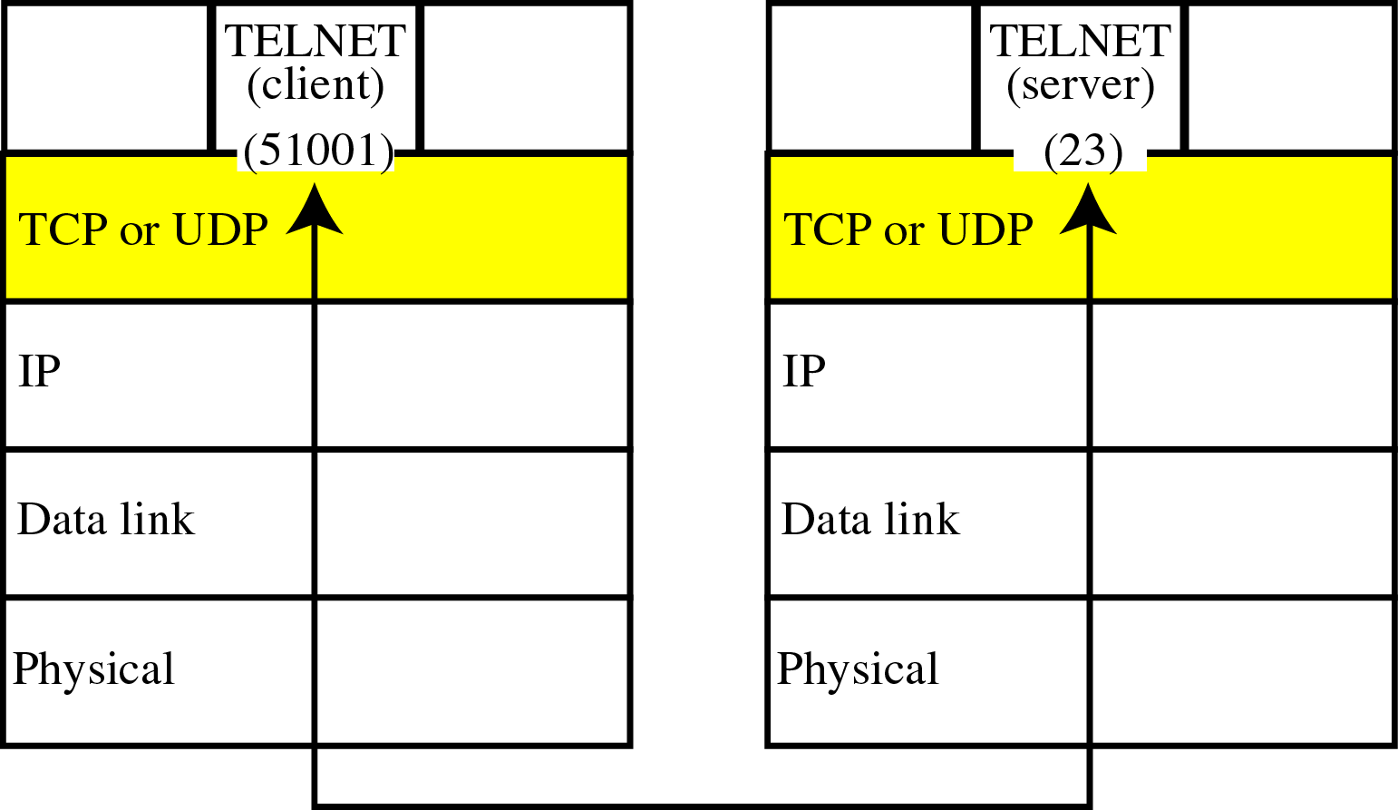
Port Address

Slide 42
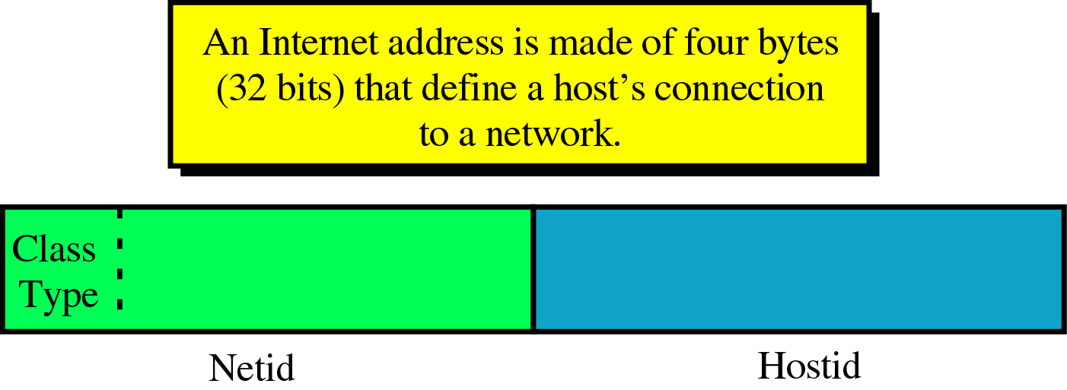
Addressing

Slide 43
Address Space
An address space is the total number of addresses used by the protocol.
If a protocol uses N bits to define an address, the address space is 2^{n.}
IPV4 uses 32-bit address, which means that the address space is of 2³² .

Slide 44
Addressing
It can be either
  Classful Addressing
  Classless Addressing

Slide 45
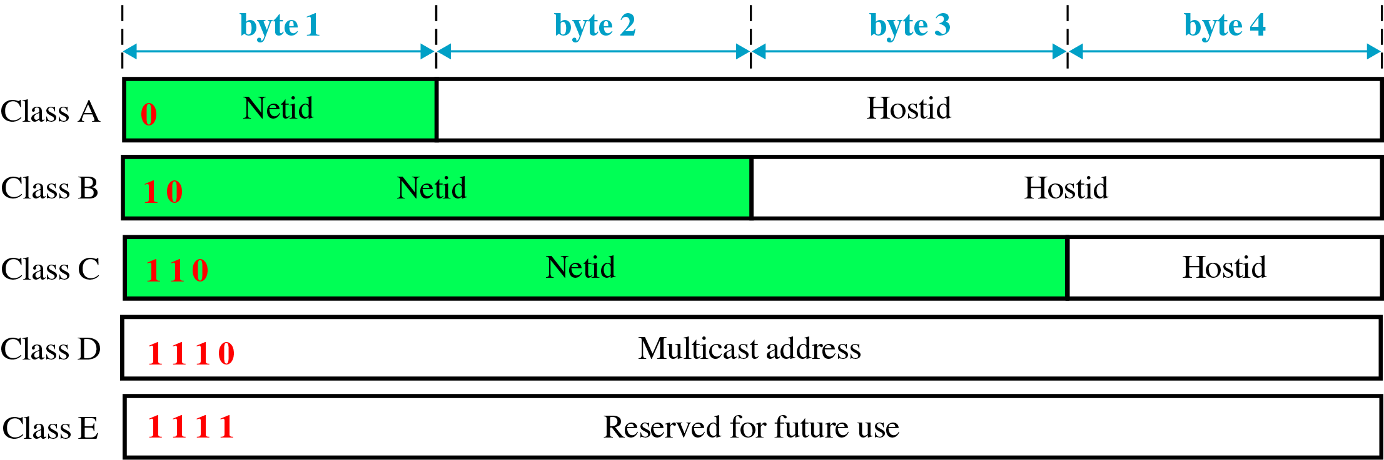
Internet Classes

Slide 46
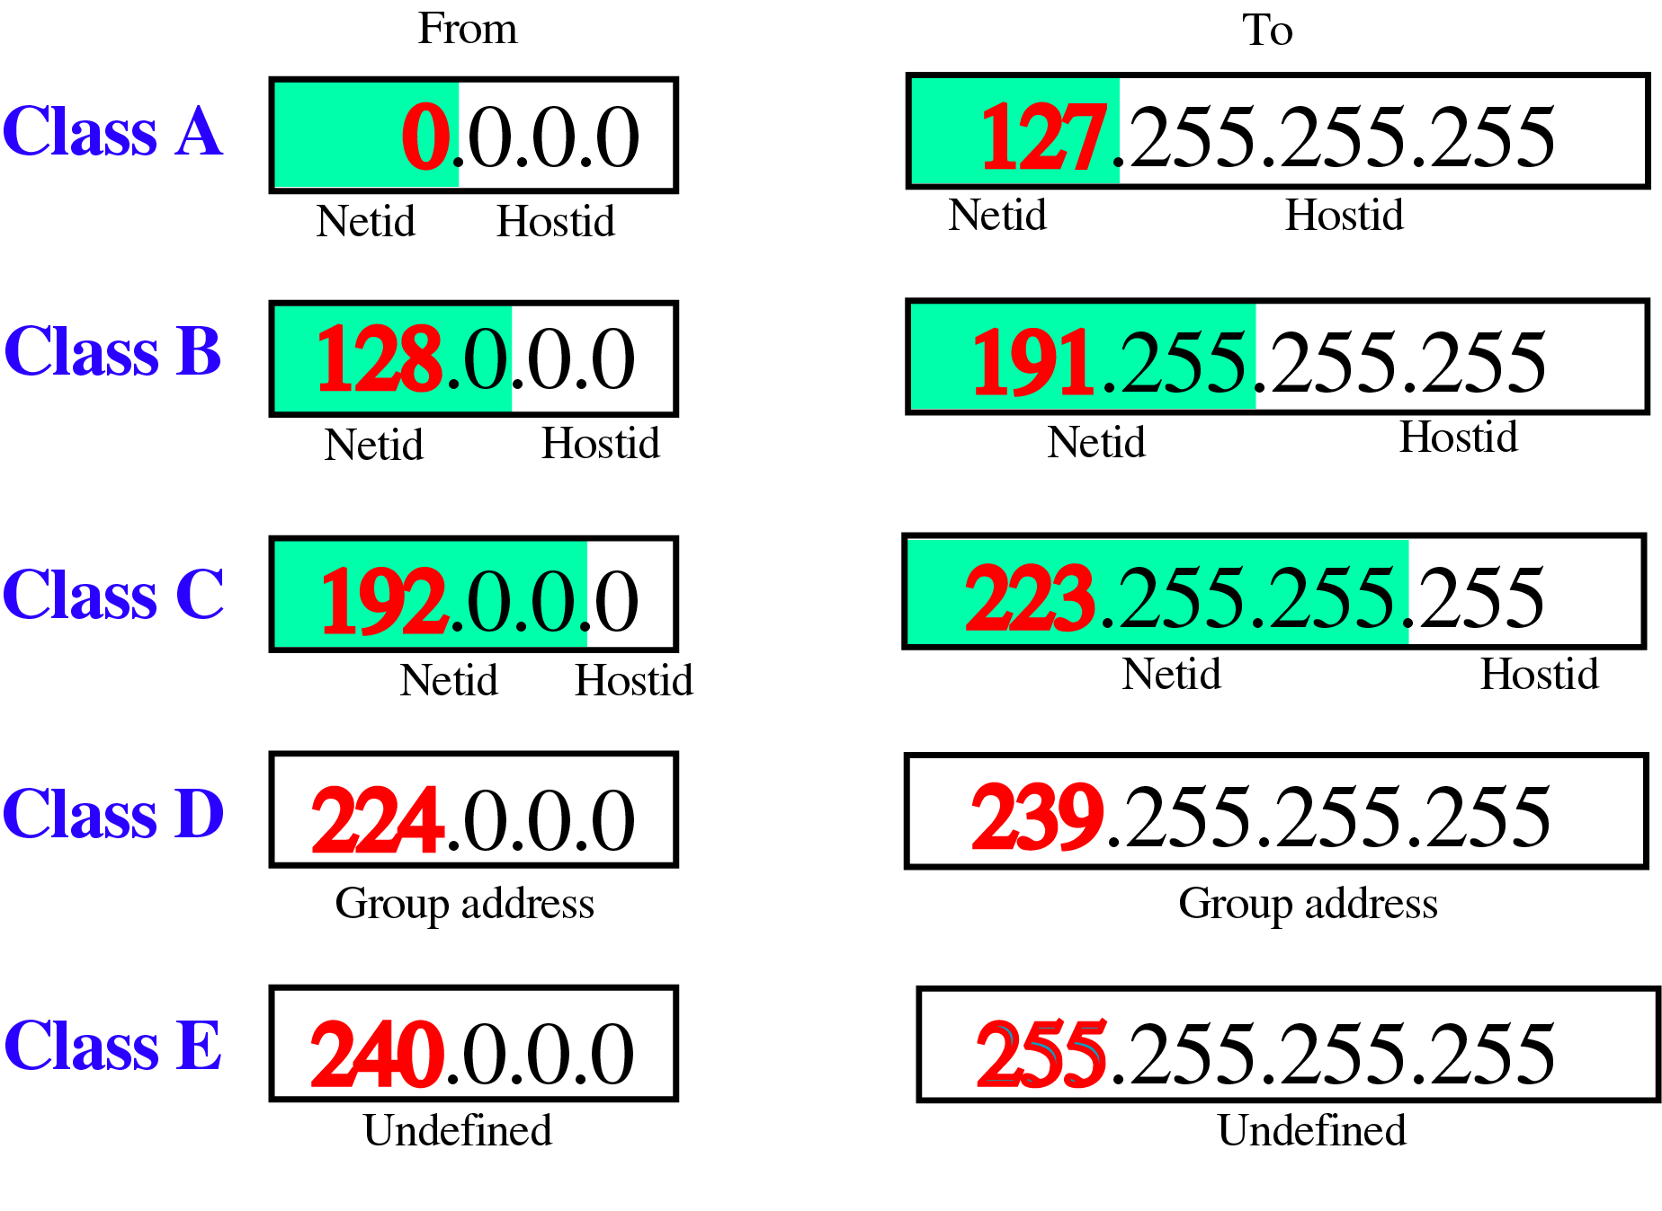
Class ranges if Internet Addresses

Slide 47
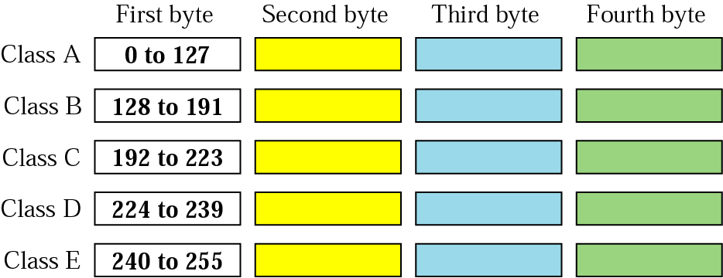
Finding a class

Slide 48
Addressing
How to define class?
→For example,
00000001 00001011 00001011 11101111
11000001 10000011 00011011 11111111
10100111 11011011 10001011 01101111
11110011 10011011 11111011 00001111

Slide 49
Class A
Class A is divided into 128 blocks with each block having different netid.
The first block covers addresses from 0.0.0.0 to 0.255.255.255.
The second block covers addresses from 1.0.0.0 to 1.255.255.255 and so on.
Class A addresses were designed for large organizations with large number of hosts or routers attached to that network.
The number of addresses in each block 16,777,216, is larger than the needs of almost organization, so many of them are wasted.

Slide 50
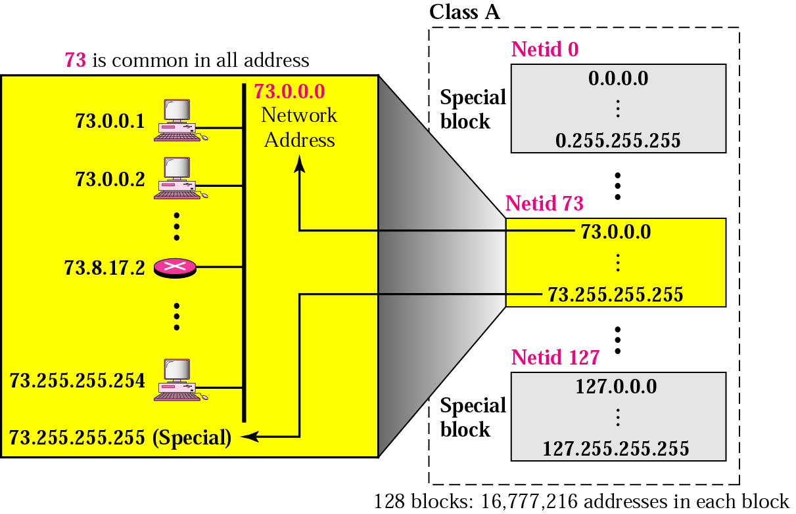
Addressing

Slide 51
Class B
Class B address is divided into 16,384 blocks with each block having different netid.
16 blocks are reserved for private address.
Remaining 16,368 blocks are for assignment to organizations.
Each block contains 65,536 addresses.
First block covers addresses from 128.0.0.0 to 128.0.255.255.255
Second block contains 129.0.0.0 to 129.0.255.255.255 and so on.
Class B were designed for mid size organizations.
However the number of addresses in each block are larger than the requirement of any mid size organizations so many addresses are also wasted in this class.

Slide 52
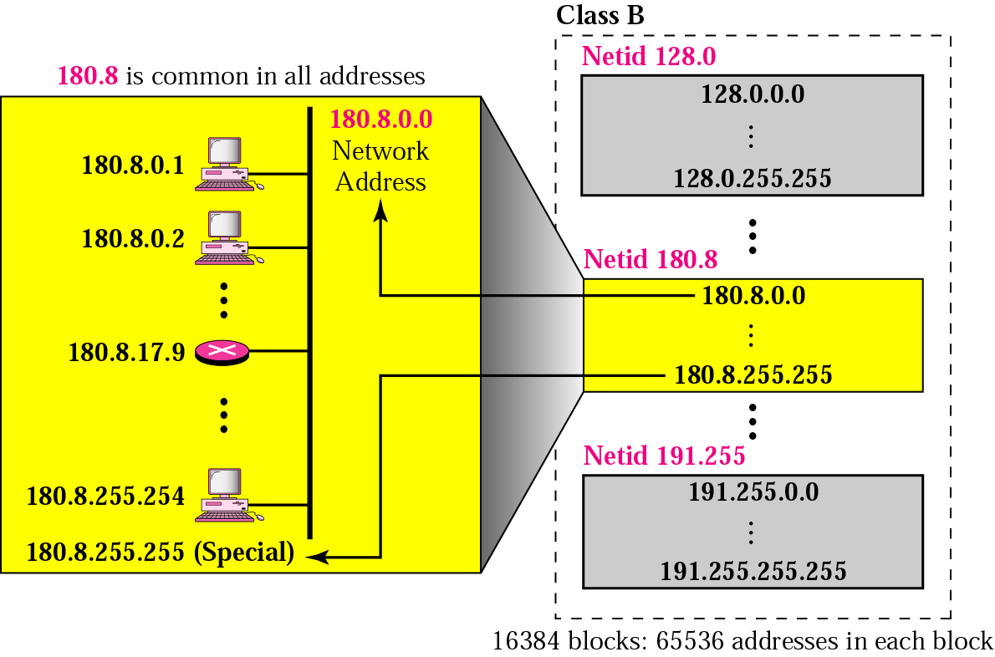
Class B

Slide 53
Class C
Class C is divided into 2,097,152 blocks with each block having different netid.
256 block are reserved for private address.
Each block contains 256 address.
Small organization can use it.
The number of addresses in each block is so limited that most organizations do not want a block in this class.

Slide 54
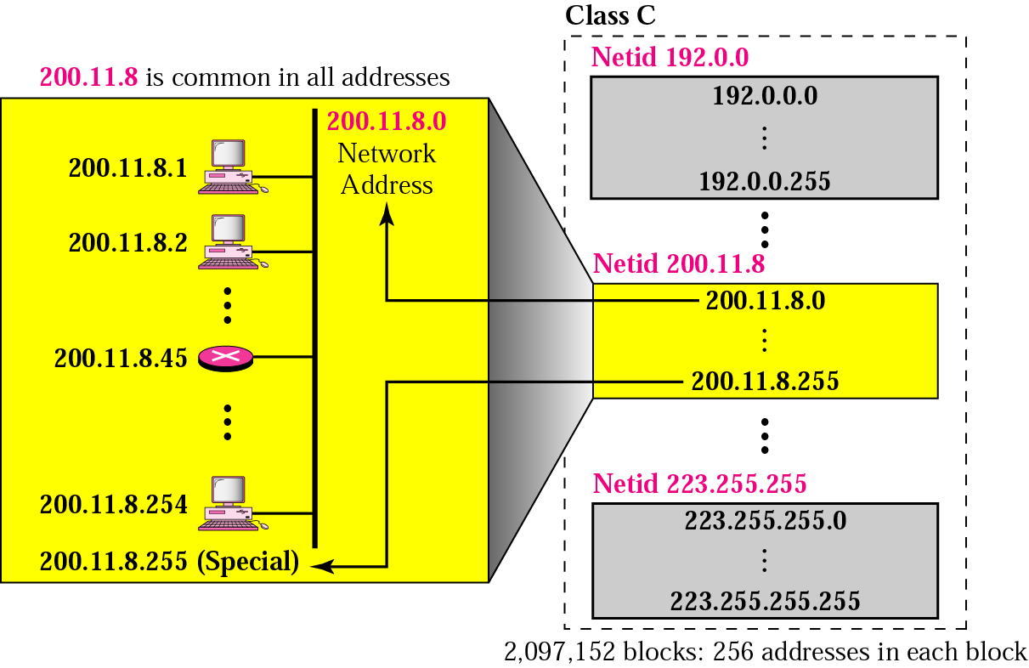
Class C

Slide 55
Class D
There is just one block of class D addresses.
It is designed for multicasting.

Slide 56
Class E
There is only one block in this class.
It was designed for use as reserved addresses.

